Slide 1

HERBAL DRUG TECHNOLOGY
CLASS-9
TOPIC: Preparation and standardization of Ayurvedic formulations: arista, asava and leha
BP603T.
BY
B.RATNA DEEPTHI
Academic year-2020-21
RAGHU COLLEGE OF PHARMACY
Dakamarri ,Bheemunipatnam madndalam,Visakhapatnam 531162

Slide 2
Preparation and standardization of Ayurvedic formulations
Aristas
Arishta are ayurvedic preparations that contains self-generated alcohol content and herbal extracts soluble in both water as well as alcohol.
Fermentation is brought about by the addition of Dhataki flowers(Woodfordia fruticosa)
Fermented alcohol facilitate the extraction of active constituents in the drug and also act as a preventive.
Arista contain upto 12% of alcohol and also called as medicinal wine.
Arista is prepared by decoction of herbs in boiling water.

Slide 3
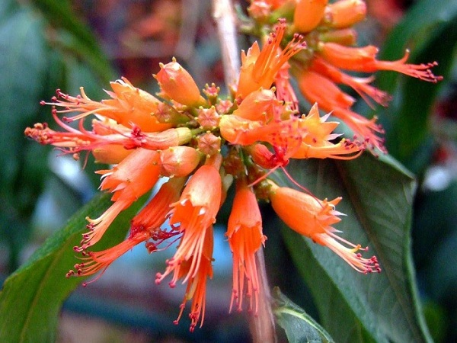
Dhataki flowers(Woodfordia fruticosa)

Slide 4
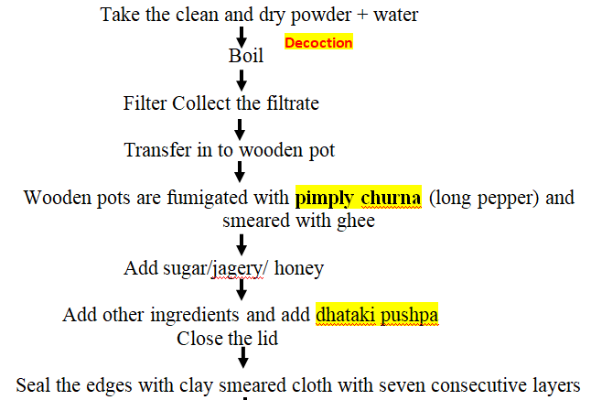
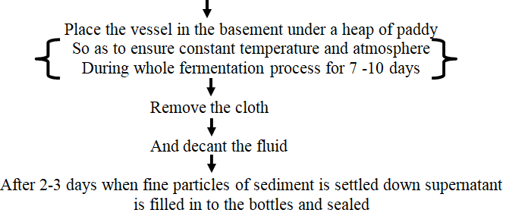
Method of preparation

Slide 5
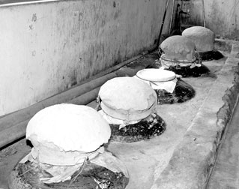

Slide 6
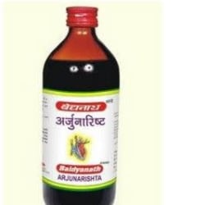
Examples of arista:
Ashokarishta
Draksharista
Arjunarista
Dashmoolarista
Shelf Life: Much longer time
Storage Conditions:
Should be stored in air tight container
Narrow mouthed
Store in cool place
Away from sunlight

Slide 7
standardization of arista
1. Preliminary evaluation
Determination of organoleptic characteristics viz.
odour, taste, colour and clarity was teated.
2. Determination of alcohol content
3. Total solid content
10g of a formulation was taken in evaporated dish which was previously weighed and allowed to evaporate so that only solid content remains in the dish and rest of the fluid gets evoporated. Then it again weighed and the solid content of formulation calculated
4. pH
Calibrated pH meter was used to check the pH of formulation

Slide 8
5. Viscosity
Viscosity of arista was determined with the help of Brookfield viscometer.
6. Refractive Index
The Refractive Index of formulation was found out by using Abbe’s Refractometer.
7. Acid value
Acid value was determined as per the procedure given in Indian Pharmacopoeia

Slide 9
8. Total phenolic content
Absorbance of standard tannic acid solutions are recorded on UV visible spectrophotometer (Shimadzu-1800) at 750 nm and standard curve is plotted. Sample of arista prepared as per Ayurvedic Pharmacopoeia of India and processed for estimation of total phenolic content

Slide 10
Preparation and standardization
2. Asava
Asava are ayurvedic liquid preparations that contains self-generated alcohol content and herbal extracts soluble in both water as well as alcohol.
Fermentation is brought about by the addition of Dhataki flowers(Woodfordia fruticosa)
Fermented alcohol facilitate the extraction of active constituents in the drug and also act as a preventive.
Asava contain upto 12% of alcohol and also called as medicinal wine.
Asava is prepared by infusion method by direct use of herbal juices.

Slide 11
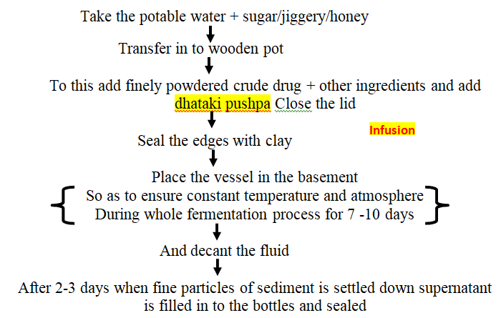
Preparation of asava

Slide 12
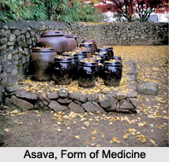

Slide 13
Examples of asava:
Chandanasva
Lauhasava
Drakshasava
Shelf Life: Much longer time
Storage Conditions:
Should be stored in air tight container
Narrow mouthed
Store in cool place
Away from sunlight

Slide 14
Standardization of asava
1. Preliminary evaluation
Determination of organoleptic characteristics viz.
odour, taste, colour and clarity was teated.
2. Determination of alcohol content
3. Total solid content
10g of a formulation was taken in evaporated dish which was previously weighed and allowed to evaporate so that only solid content remains in the dish and rest of the fluid gets evaporated. Then it again weighed and the solid content of formulation calculated
4. pH
Calibrated pH meter was used to check the pH of formulation

Slide 15
5. Viscosity
Viscosity of asava was determined with the help of Brookfield viscometer.
6. Refractive Index
The Refractive Index of formulation was found out by using Abbe’s Refractometer.
7. Acid value
Acid value was determined as per the procedure given in Indian Pharmacopoeia

Slide 16
8. Total phenolic content
Absorbance of standard tannic acid solutions are recorded on UV visible spectrophotometer (Shimadzu-1800) at 750 nm and standard curve is plotted.

Slide 17
3. Leha
Leha is also called as avaleha or paka, is a semisolid ayurvedic preparation consisting of kasayas or powder drug along with jaggery or khandasari sugar and ghee or oil or liquid.
Ex: Vasavaleha, Dhrakshavaleha, Musalipaka, Suvarnleha.

Slide 18
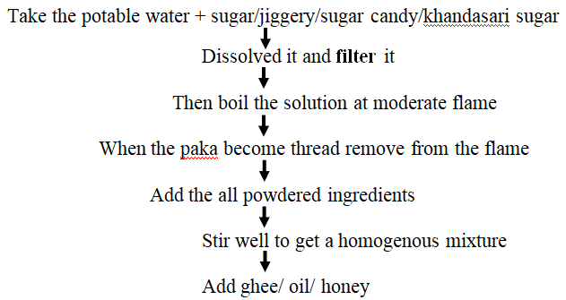
Method of preparation of Leha

Slide 19
Standardization of leha
1. organoleptic evaluation: colour, odour, taste
2. Physical evaluation
LOD at 105°C
Total ash
Acid insoluble ash
Total solid content
Ph
Fat content
3. Test for reducing sugar
4. Total sugar
5. Chromatography
6. Test for heavy metals
7. Microbial contamination
8. Shelf life

