Slide 1

BP603T.
HERBAL DRUG TECHNOLOGY
CLASS-5
TOPIC: Pests & Pest control
BY
B.RATNA DEEPTHI
Academic year-2020-21
RAGHU COLLEGE OF PHARMACY
Dakamarri ,Bheemunipatnam madndalam,Visakhapatnam 531162

Slide 2
Pest
Definition:
Pests are undesired plant or animal species that causes a great damage to the plants.
Types of pests:
Fungi and viruses
Insects
Weeds
Non insect pests

Slide 3
Fungi and viruses
Fungi:
Name of the fungi | Disease caused
Ascochyta atropae | Leaf necrosis ie formation of greyish white irregular spots
Cercospora atropae | Leaf spot- round angular brown spots with chestnut coloured margin on both side of the leaves
Phytophthera nicotiana | Phytophthera rootrot in belladona plant causing dropping of young leaves and branches, yellowing of older leaves and drying of whole plant.

Slide 4
Virus:
TMC: Tobacco mosaic virus
Tobacco ring spot virus
cucumber mosaic virus
Viruses are generally affects: rauwolfia, tobacco, datura, vinca, eucalyptus.
Other viruses: Yellow vein mosaic virus, Graft transmissible virus, Ruguse leaf curl virus.
Effecting digitalis
Effecting hyoscyamus

Slide 5
Insects
Agrotis species, Heliothis armiger, Odonthotermer obesus (mentha), Flea beetles
Plantia Viridicolis, Diaphania nilgirica, Indomia cretaceus--- Rauwolfia serpentina
Papilio machen, Hydaphis coriandri---Dill fruit
Gonocephalum species, Agrotis flammantra---Belladona leaves
Other insects: grass hopper, spiders, tics, mites etc.

Slide 6
weeds
Rag weed, medican tea, yelloduck weed, parthinium, western poisionous oak, datura.
Non insect pest
They are divided in to vertebrates and invertebrates.
Vertebrates that disrupt the plants are monkeys, rats, birds, squirrels, etc.
Non vertebrates are, Web spinning Spider, Mites causes discoloration in leaves and yellow spots.
Nematodes (Meloidogyne incognita) (Xiphinema americanutri)
(Criconemella xenoplax) produces giant cell formation, disturbs
the uptake of nutrients and water, and interferes with plant growth, crabs, snails are the other few invertebrates that causes trouble to the plant.

Slide 7
Pest control
These following methods are generally used:
Mechanical method
Agricultural method
Biological method
Biopesticides
Bioinsectisides

Slide 8
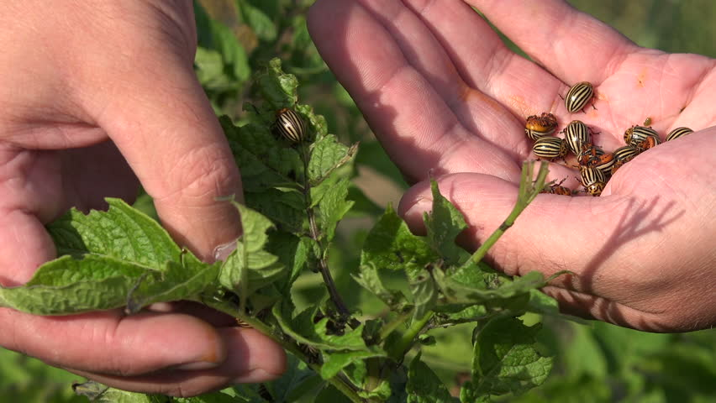
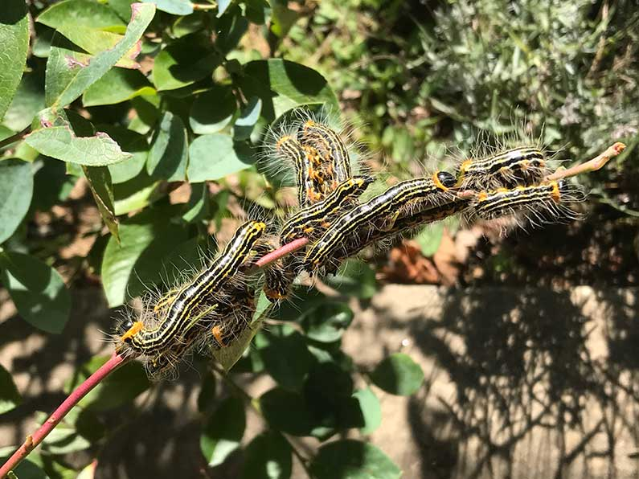
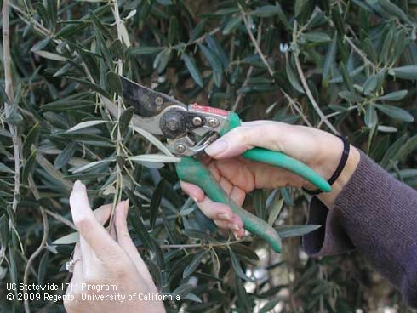
Mechanical method
By hand picking---------
Pruning---------

Slide 9
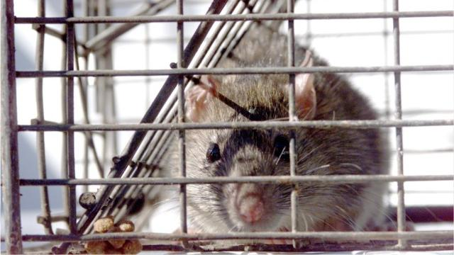
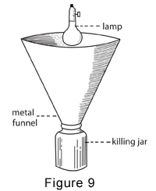
Burning
Trapping of pest-by using traps/rat traps---
Trapping of flying insects

Slide 10
Agricultural method
Production of pest resistant species used to resistant fungus and bacterial attack.
Use of deep sloughing to eradicate weeds.
Another method for removal is crop rotation.

Slide 11
Biological pest control
Importation or classical biological control: which introduce pest’s natural enemies to the location.
Augmentation: it involves supplemental release of natural enemies, boosting the naturally occurring population.
Conservation: conservation of existing natural enemies in the environment.
Biological phermones: pheromones are chemicals used by insects and other animals to communicate with each other. Insects send these chemical signals to help attract mates, warn others of predators, or find food. Using specific pheromones, traps can be used to monitor target pests in agriculture or in residential areas Ex: 7,8-epoxy-2-methyl octodecane from gypsy moth.

Slide 12
Biopesticides
Biopesticides are developed from naturally occurring living organisms such as animals, plants, and microorganisms (e.g., bacteria, fungi, and viruses) that can control serious plant- damaging insect pests by their nontoxic eco- friendly mode of actions.
Types of biopesticides:
Microbial pesticides
Plant incorporated pesticides
Biochemical pesticides
Botanical pesticides
Biotic agents (parasitoids & predators)

Slide 13
Advatages of biopesticides
Inherently less harmful and less environmental damage.
Designed to affect only one specific pest or, in some cases, a few target organisms,
Often effective in very small quantities and often decompose quickly, thereby resulting in lower exposures and largely avoiding the pollution problems .
When used as a component of Integrated Pest Management (IPM) programs, biopesticides can contribute greatly.

Slide 14
1. Microbial pesticides
Microbial pesticides are composed of microscopic living organisms (viruses, bacteria, fungi, protozoa, or nematodes) or toxin produced by these organisms
Applied as conventional insecticidal sprays, dusts, or granules.
Their greatest strength is their specificity as most are essentially nontoxic and non pathogenic to animals and humans.
Microbial pesticides includes insecticides, fungicides, herbicides and growth regulators of microbial origin.

Slide 15
Some of the important microbial pesticides
a. Bacillus thuringiensis
Discovered in Japan in early 20th century and first become a commercial product in France in 1938.
Control lepidopterous pests like American bollworm in cotton and stem borers in rice.
When ingested by pest larvae, Bt releases toxins which damage the mid gut of the pest, eventually killing it.
Main sources for the production of Bt preparations are the strains of the subspecies kurstaki, galeriae and dendrolimus

Slide 16
b. Agrobacterium radiobacter (Agrocin):
Agrobacterium radiobacter is used to treat roots during transplanting, that checks crown gall.
Crown gall is a disease in peaches, grapevine, roses and various plants caused by soil borne pathogen Agrobacterium tumefaciensm.
The effective strains of A. radiobacter posses two important features: 1) They are able to colonize host roots to a higher population density. 2)They produce an antibiotic, agrocin, that is toxic to A. tumefaciens.

Slide 17
c. Pseudomonas fluorescens (Phenazine)
•This bacteria is used to control damping off caused by Pythium sp., Rhizoctonia solani, Gaeumannomyces graminis.
•It has ability to grow quickly in the rhizosphere
d. Trichoderma
•Trichoderma is a fungicide effective against soil born diseases such as root rot.
•This is also used against Necteia galligena, that causes silver leaf disease of fruit trees by entering through pruning wounds.

Slide 18
e. Metarizium anisopliae
•It infects spittlegbugs, rhinoceros beetles.
f. Beauveria bassiana
• Controls Colorado potato beetle.
g. Verticillum lecanii:
•Controls aphids and whiteflies.
h. Nomuraea riley:
• Controls soybean caterpillars.
i.Baculo viruses(Bvs)
• Control lepidopterous and hymenopterous pests.
•Rod shaped, circular double stranded super coiled DNA.

Slide 19
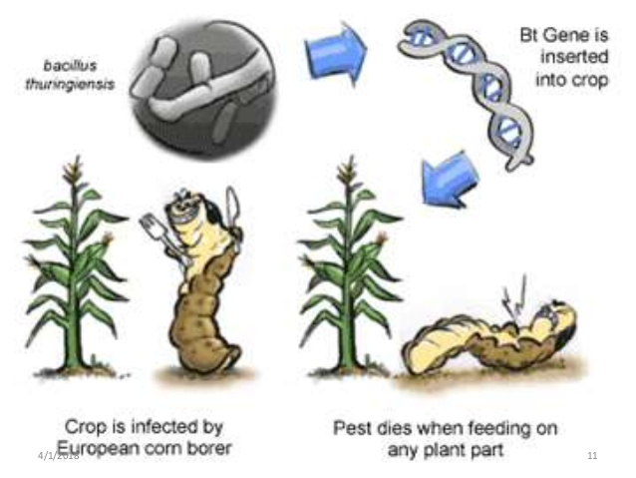
Plant-incorporated-protectants (PIPs)
Pesticidal substances that plant produce from the genetic material that has been added to the plant.
As the pest feed on such plants they will eventually die.
Theses (PIPs) are also called as genetically modified crops.
Ex: Bt-Protein is developed as PIP by genetic engineering. This protein cause death with in 48 hours but it is safe to all vertebrae and environment.

Slide 20
Botanical pesticides
• These are naturally occurring plant material that may be crude preparation of the plant parts ground to produce a dust or powder that can be used in full strength or dilute form in a carrier such as clay, talc or diatomaceous earth.
Ex: “Azadirachtin” effects the reproductive and digestive process of pest.
• Several plant based insecticides as nicotinoids, natural pyrethrins, rotenoids, neem products etc are used.

Slide 21
Biochemical pesticides
They are naturally occurring substance to control pest by non-toxic mechanisms.
• Biochemical pesticides include substances as insect sex pheromones, that interfere with mating that attract insect pest to traps.
The synthetic attract ants are used in one of four ways:
i. As a lure in traps used to monitor pest populations;
ii. As a lure in traps designed to “trap out” a pest population;
iii. As a broadcast signal intended to disrupt insect mating
iv. As an attractant in a bait (food placed in hook) containing an insecticide

Slide 22
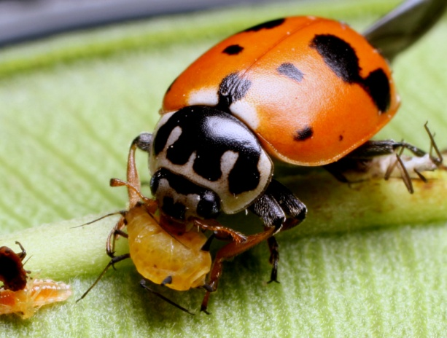
Biotic agents/Natural enemies
a) Predators
They consume several to many prey over the course of their development, they are free living and they are usually as big as or bigger than their prey.
Ex: lady beetles, rove beetles, many ground beetles, lacewings, true bugs such as Podisus and Orius, syrphid fly larvae, mantids, spiders, and mites such as Phytoseiulus and Amblyseius.

Slide 23
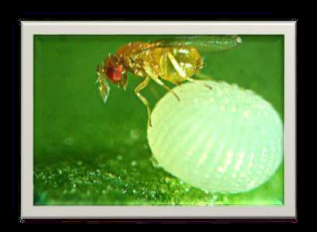
b) Parasitoids:
Parasitoids are almost the same size as their hosts, and their development always kills the host insect.
• An adult parasitoid deposits one or more eggs into or onto the body of a host insect or somewhere in the host’s habitat.
• The larva that hatches from each egg feeds internally or externally on the host’s tissues and body fluids, consuming it slowly.
• Later in development, the host dies and the parasitoid pupates inside or outside of the host’s body.
Ex: Bathyplectes, trichogramma, encarsia, muscidifurax etc.

