Slide 1

BP603T.
HERBAL DRUG TECHNOLOGY
CLASS-4
TOPIC: Organic farming
BY
B.RATNA DEEPTHI
Academic year-2020-21
RAGHU COLLEGE OF PHARMACY
Dakamarri ,Bheemunipatnam madndalam,Visakhapatnam 531162

Slide 2
Organic farming
Definition:
Organic farming is a ecological production management system that promotes and enhances biodiversity, biological cycle and soil biological activity. It is based on minimal use of off- farm inputs and on management practices that restore, maintain and enhance ecological harmony.
Or
Organic farming is a system which avoids or largely excludes the use of synthetic inputs (such as fertilizers, pesticides, hormones, feed additives etc.) and to the maximum extent feasible rely upon crop rotations, crop residues, animal manures, off-farm organic waste, mineral grade rock additives and biological system of nutrient mobilization and plant protection.

Slide 3
Principles of organic farming
There are four principles of organic farming are as follow:-
Principles of Health – The health of the ecosystem, people, and communities.
The Principles of Ecology – The right balance between ecosystem and environment or nature.
Principles of Fairness – Good human relationships and quality of life.
Principles of Care – The considerations about the environment and environment of the future.

Slide 4
Objective of organic farming
OBJECTIVES OF ORGANIC FARMING
2. Work with natural system
3. Maintain and increase soil fertility
4. Use renewable resources as far as possible
5. Avoid pollution
6. Wider social and ecological impact of farming system
1. Produce food with higher nutritional quality

Slide 5
TYPES OF ORGANIC FARMING
I) Pure organic farming : It includes use of organic manures and biopesticides with complete avoidance of inorganic chemicals and pesticides. II) Integrated Farming : It involves Integrated Nutrient Management (INM) and Integrated Pest Management (IPM).
Integrated Farming Systems : In this type, local resources are effectively recycled by involving other components such as poultry, fish pond, mushroom, goat rearing etc. apart from crop components. It is a low input organic farming.

Slide 6
COMPONENTS OF ORGANIC FARMING
There are some techniques by which organic farming in India practiced:-
Crop rotation
Crop residue
Organic manure
Biofertilizers
Biopestisides

Slide 7
1. Crop rotation: A technique to grow various kinds of crops in the same area, according to different seasons, in a sequential manner. Legume are essential in any rotation. This will be useful to increase the soil fertility management, weed management, disease control.
2. Crop residue: Incorporation of crop residue ex. Wheat and rice straw as such or incorporated with fungal species has beneficial effects on crop yields and improvement in physico-chemical properties of soil.
3. Organic manure:
Bulky organic manure:
  FYM (Farm Yard Manure): well-decomposed mixture of dung, urine, farm litter and left over or used up materials from roughages or fodder fed to the cattle.
  Compost: waste materials like vegetable refuse, farm litter such as weeds, stubble, straw, sugarcane trash, sewage, sludge and animal waste in houses, areas like human and industrial waste can be converted in to useful compost manure by anaerobic decomposition.
  Green manuring: practice of ploughing and incorporation of under composed green plant tissues for the purpose of improving physical structure as well as fertility of the soil. Example: Sunhemp, Dhaincha Clusterbean, Cowpea, Berseem.

Slide 8
b) Concentrated organic manure: Organic matter containing higher percentage of essential plant nutrients such as nitrogen, phosphorus, and potash, as compared to bulky organic manures. These are made from raw materials of animals or plant origin. ex: oil cakes, bloodmeal, fish meal, meat meal and horn and hoof meal.
c) Vermicompost: The organic manure produced by the activity of earth worms. The worms- live: they live in the soil; eat: the biomass; excrete: the valuble “vermi-cast”. The common worms are Eisinia foetida, dendrobanenae spp.
4. Biofertilizers: A biofertilizer is a substance contains living micro organism can be applied to the seeds, plants surface or soil; it will be colonies and promotes growth by increasing the nutrient supply or availability of primary nutrients. These are two types:
Symbiotic N-fixation: Rhizobium: colonize in the roots of Leguminosae plants and form tumorous growth can fix 100-300Kg/ha in one crop season, Mycorrhizae: symbiotic association with fungi with roots of vascular plants.
Asymbiotic N-fixation: they grow on decomposing soil organic matter and produce nitrogen compound. Ex: Azotobacter, Azospirillium, Blue green algae, Azolla.

Slide 9
5. Biopesticides:
Biopesticides are the natural plant products containing secondary metabolites shows biological insecticidal property. Ex: Nicotine, Pyrethrum, Rotenone, Quassia Margosa, Acorus, Ryanin, Subabilla etc.

Slide 10
Methods of organic farming
Soil management
Weed management
Crop diversity
Controlling other organism

Slide 11
1. Soil Management
Soil Management: Soil management is the primary technique of organic farming in India. After cultivation, soil loses its nutrients, and its fertilizer goes down. The process in which soil is recharging with all the necessary nutrients called soil management.
Organic farming uses natural ways to increase the fertility of the soil. It uses bacteria, available in animal waste. The bacteria helps in making the soil more productive and fertile.

Slide 12
2. Weed management
Weed”, in simple words, is nothing but the unwanted plant that grows in agricultural fields. However, in organic agriculture, there is more focus on suppressing the weed rather than eliminating it completely.
The two most widely used weed management techniques are:
1. Mulching – a process wherein plastic films are used in order to block the growth of weed
2. Mowing and cutting – wherein there is a removal of weeds’ top growth

Slide 13
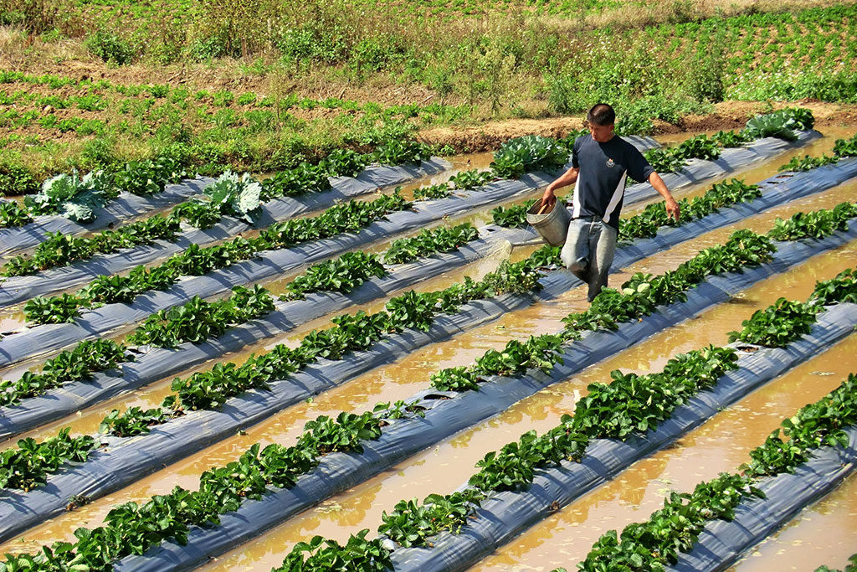
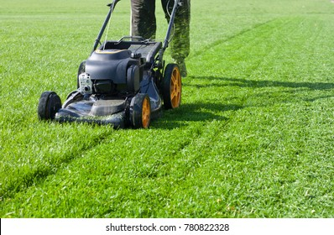
Mulching
Mowing and cutting

Slide 14
3. Crop Diversity
Diversity within a crop includes genetically-influenced attributes such as seed size, branching pattern, height, flower color, fruiting time, and flavor

Slide 15
Crop diversity is the variance in genetic and phenotypic characteristics of plants used in agriculture. ... Crop diversity loss threatens global food security, as the world's human population depends on a diminishing number of varieties of a diminishing number of crop species.
Earlier, Monoculture was the only practice used in the agricultural fields wherein only one type of crop was harvested and cultivated in a particular location. However, in the recent world, Polyculture has come into the picture wherein different kinds of crops are harvested and cultivated in order to meet the increasing crop demand and produce the required soil microorganisms.

Slide 16
4. Controlling other organism
Controlling of other organism can be done by using herbicides to protect from weeds and pestisides, to protect from pests.

Slide 17
Benefits of organic farming
Increase the long term soil fertility
Control pests and diseases without harming the environment
Disease and pest resistance plants can be produced
Weed competitiveness
Lower input of cost
Drought resistance

Slide 18
Limitations of organic farming
Organic mannure is not abundantly available.
Production in organic farming declines during first few years
Understanding about organic production, processing, certification are beyond the understanding of ordinary Indian farmer.
Marketting of organic products is not properly streamlined.
Inability to Use Genetically Modified Crops.

Slide 19
Main issues for organic farming
Standards:
  Globally:61 standards available (IFOAM (International Federation of Organic Agriculture and Movement) CODEX, EU (European Unit), Demeter, Japanese Agricultural Standard (JAS), Naturland, etc.
  Indian Standard: NPOP (National Programme for Organic Production); APEDA (Agricultural and Process Food Products Export Development Authority )
Inspection certification (India): Ecocert (G) (Aurangabad), Skal (N) (Bangalore), IMO (S) (Bangalore), SGS (S) (Gurgaon), Naturland (G) (Gurgaon), Lacon (G) (Cochin), Indocert (S) (Cochin), APOF (Bangalore), ISCOP (India Society for Certification of Organic Products, Coimbatore), Bioinspectra(S)(Cochin), IRFT Mumbai
Accreditation:National Accreditation Board
Input
Market

