Slide 1

BP603T.
HERBAL DRUG TECHNOLOGY
CLASS-2
TOPIC: Selection, identification and authentication of herbal materials
Processing of herbal raw material
BY
B.RATNA DEEPTHI
Academic year-2020-21
RAGHU COLLEGE OF PHARMACY
Dakamarri ,Bheemunipatnam madndalam,Visakhapatnam 531162

Slide 2
Selection, identification and authentication of herbal materials
Selection of herbal drugs:
Phytomedicine must contain an active ingredient exclusively derived from plant materials. Thus for the selection of phytomedicine it is required to have knowledge of well defined plant species, including its botanical characterization. There are various techniques can be follow for the selection of herbal material:

Slide 3
Techniques for selection of herbs
The randomized approach
The ecological approach
The Chemosystematics approach
The ethno guided approach
1. The randomized approach: it is an approach without any criteria. It consist of random selection and collection of plant species for study, according to the availability of the plant. It is carried out for the probability of finding novel drug.

Slide 4
2. The ecological approach: The ecological approach is based on field observations and consists of observations on interactions between organisms in their ecological environment.
This approach searches for secondary metabolites and biological activities. Ex: antimicrobial, insecticidal constituent in plant, alkaloids present in plants etc.

Slide 5
The Chemosystematics approach:
This system created by professor Otto Rachard gottlieb (1982) to organize and understand the plant
This system includes identifying groups of chemical present in plants, containing antiplasmodic indole derivatives used in the preparation of antimalarial drugs.
This approach includes selection of a species from a family or genus, for which some phytochemical knowledge of at least one species of the group is known.

Slide 6
The ethno guided approach: This approach consists of selecting plant species according to the suggestion of specific population groups in certain circumstances of use; highlights the search for the locally built knowledge regarding their natural resources and application in their health system.

Slide 7
Identification and authentication of herbal materials
Identification tests should be specific for the material and are usually in combination with some of the methods:
1. Systematic study of crude drugs
    Origin, common name, scientific name, nomenclature and family
    Geographical source and history
    Cultivation , collection, preservation and storage
    Organoleptic evaluation
2. Microscopic evaluation
    Leaf constant
    Types of trichomes
    Types of stomata
    Quantitative microscopy
3. Physical evaluation: Chromatographic techniques
4. Chemical evaluation: preliminary screening by chemical test

Slide 8
Authentication
Authentication means the process or action of proving or showing something to be true, genuine, or valid.
Definition of authentication: Herb authentication is a quality assurance process that ensures the correct plant species and plant parts are used as raw material for herbal medicines.
Authentication is the first stage is identification of the plant species or botanical verification by the currently accepted Latin binomial name and synonyms. The steps involved in authentication are as follows:

Slide 9
Steps involved in authentication
Taxonomic
Macroscopic
Microscopic studies
Records should be maintained for
  a) Stage of collection
  b) Parts of the plant collected
  c) Regional status
d) Botanical identity such as
i) Phytomorphology
ii) Microscopial
iii) Histological analysis
iv) Taxonomical identity etc…

Slide 10
Topic-4: Processing of herbal raw material
Before using a crude drugs for production of herbal formulations, it should be properly processed so that, active constituents and appearance of the drug do not deteriorate before being used.
Processing of herbal drugs should be performed, starting from collection up to preparation of extract.

Slide 11
The processing of herbal raw materials includes following steps:
Collection
Harvesting
Drying
Garbelling
Packing
Storage of crude drugs
Pulverization
Extraction and drying of herbal extract

Slide 12
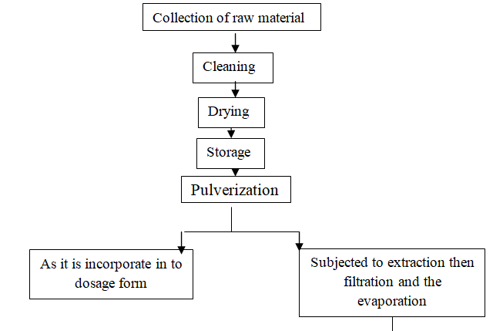
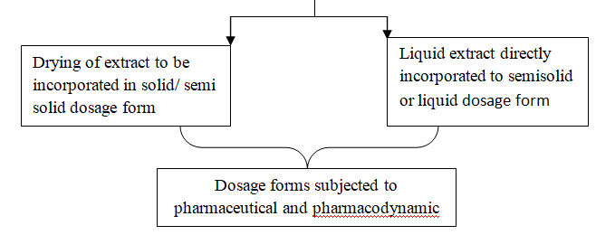
FLOW CHART FOR PROCESSING OF HERBAL FORMULATION:

Slide 13
1. COLLECTION
Reliable natural source:
Either cultivated or wild natural source must be reliable and authenticated.
b) Collection by skilled or unskilled labors: skilled labors: opium collection, ipecac, digitalis, cinnamon. Unskilled labors: collection of fruits, flowers, senna gums etc
c) Seasonal collection: warm climate : rhubarb (anthraquinanes), rainy season: cinnamon, cinchona, roots and rhizomes: autumn season
d) Age of plant: leaves: before flowering, clove: buds, rhizomes: maximum size, gums: slightly dried etc.
e) Geographical location: ex: Ammi visnaga: mid terranean wild source more variety of coumarins and chromones where as in arizona variety: more seeds no constituents

Slide 14
2. Harvesting
Cutting the parts of plants containing medicinal value and gather them
Leaves: by plucking
Roots and rhizomes: by uprooting the plant
Gum : after ripening
Flowers: fully expanded etc.

Slide 15
3. Drying
Drying
Natural drying
Direct sun
Shade
Artificial drying
Tray drying
Vacuum drying
Spray drying

Slide 16
4. Garbelling
Removing of unwanted parts of plant other than required crude drug.
Ex:
excessive stems in lobelia leaf
Stalks and flowers in clove bud
Rootlets and roots in rhubarb
Pieces of iron in castor seeds
Pieces of bark in gum acacia

Slide 17
5. Packing
The crude drugs are packed properly to prevent the effect during transportation and storage.
Ex:
colophony and balasam-kerosine tins
Asafoetida- well closed container
Cod liver oil: away from sun light
Leaf drugs: bael
Digitalis, ergot, squill : moisture free containers
Colophony: big mass
Roots, seeds, gums: gunny bags

Slide 18
6. Storage of crude drugs
Proper storage is necessary to maintain the quality of crude drugs for prolonged time.
Proper storage
To prevent from fungal growth, bacterial growth, rodents, moisture

Slide 19
7. Pulverization
Pulverization and comminution is a process of fragmenting a substances in to small particles by mechanical forces.
It is the first step for herbal extraction
Leaf drugs: hammer mill, pin mill, cutting and shreading mill
Roots and rhizomes: shredder mill, hammer mill
Seeds and fruits: fine mill, shredder mill, pin mill, roller mill
Fruits: Oscillary beaters

Slide 20
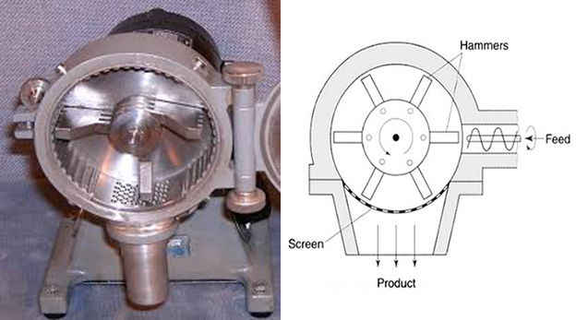
Other drugs- like flowers, gums barks etc.
Toothed disc mill
Cross beater mills
Cad milling etc.
hammer mill

Slide 21
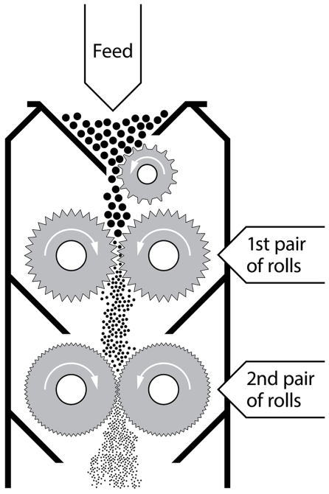
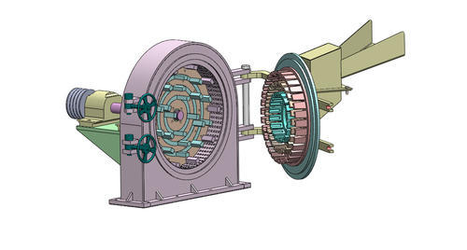
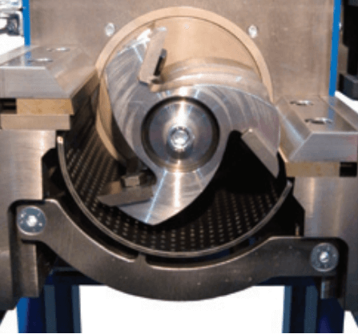
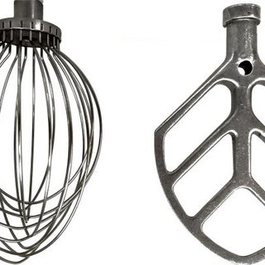
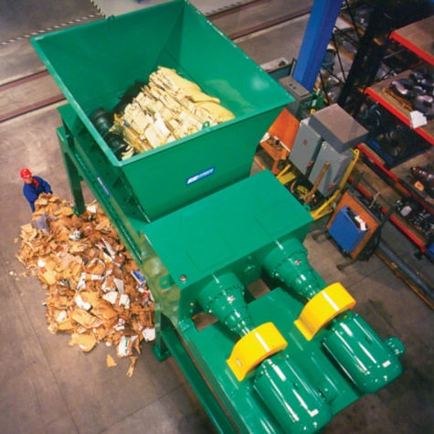
Pin mill
Cutting mill
Roller mill
shreading mill
Oscillatory beaters

Slide 22
Extraction and drying of herbal extract
Extraction process
Drying process

