Slide 1
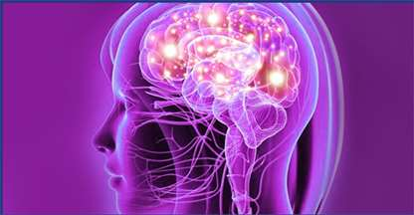
UNIT- IV
Human Anatomy & Physiology
Course code: BP101T
Program: B. Pharm

Slide 2


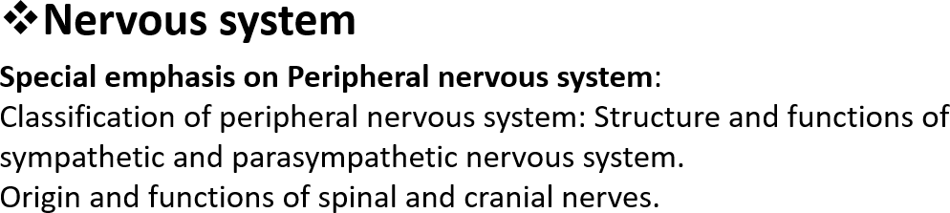
CONTENT
UNIT IV

Slide 3
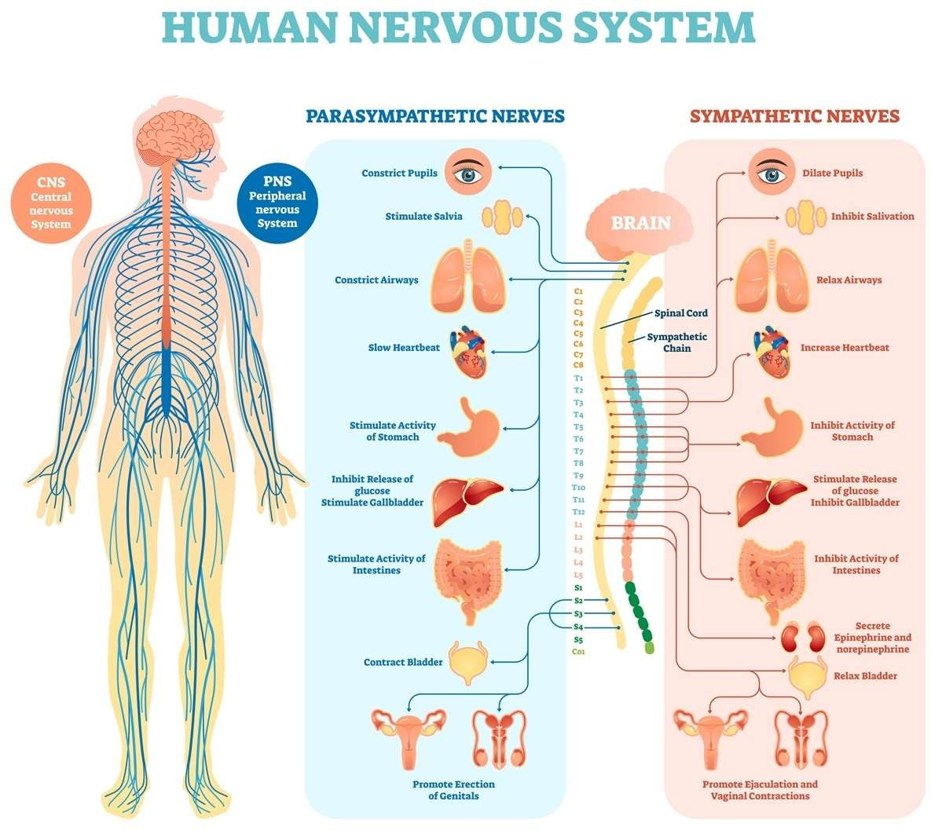
Nervous system
It is an inter connected network of cells, tissue and organ that helps us to communicate with each other and react against environmental changes.

Slide 4
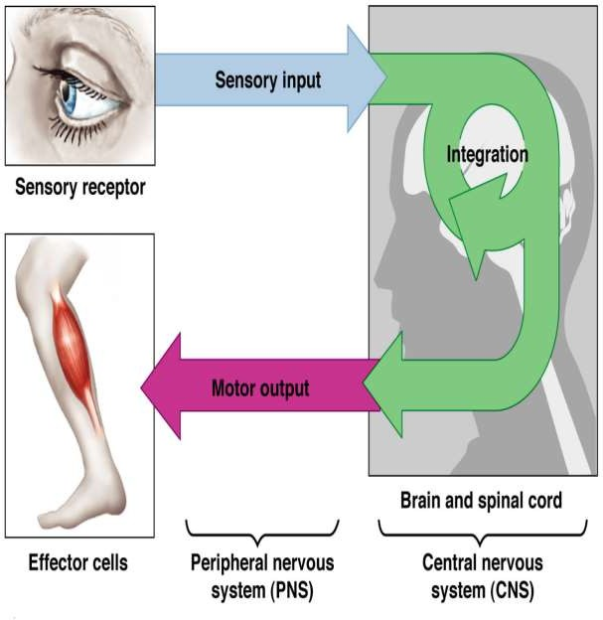
Functions of nervous system
Sensation: receiving information about the changes of environment in presence of stimuli (eg. taste, smell, touch, sight, hearing)
Integration: communication and integration of received stimuli to interpret the sensory input for proper action.
Motor output: It creates some responses against received signal by stimuli. voluntary (contraction of skeletal muscle) and involuntary (regulation of cardiac muscle and gland) response.
Mental activity
Homeostasis

Slide 5
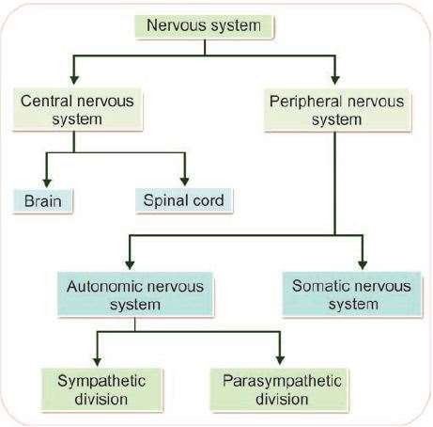
Classification of Nervous system

Slide 6
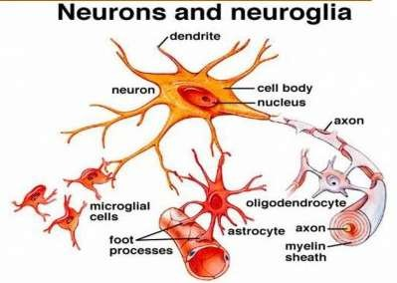
Nerve tissue
Composed of:
Neuron: receive and transmit impulses
Neuroglia: assist in the propagation of nerve impulse. They maintain homeostasis, form myelin, and provide protection
for neurons

Slide 7
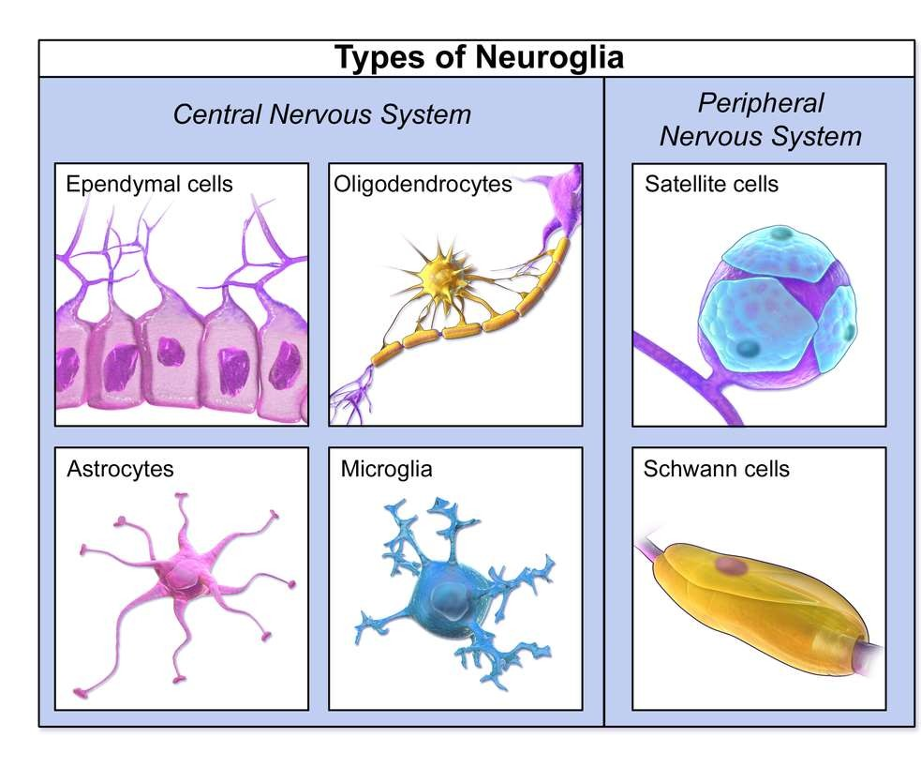
Neuroglial cell
Type of neuroglial cell in CNS:
Oligodendrocytes: form myelin sheath
Astrocytes: recycle neuro transmitter and
control chemical environment of neuron.
Microglial cell: specialized macrophage and
helps in phagocytosis.
Ependymal cell: line the spinal cord and
helps in secretion of CSF.
Type of neuroglial cell in PNS:
Schwann cell: myelination and phagocytic activity.
Satelite cell: regulate external chemical
environment.

Slide 8
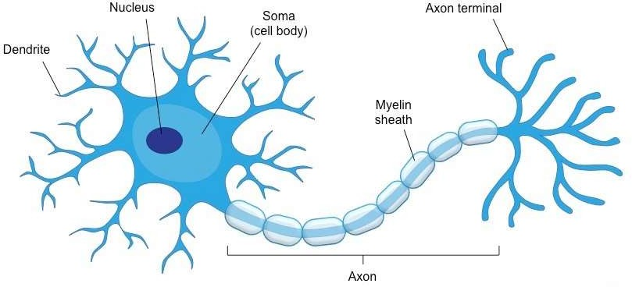
Neuron
Parts of neuron
Soma: Body of neuron. It contains nucleus and protein synthesis occurs.
Axon: cable like projection of nerve cell. It can conduct electrical nerve impulse to another neuron.
Dendrite: branched protoplasmic extension of nerve cell. It can propagate electrical impulse coming from other neural cell to soma.
Myelin sheath: lipid rich substance covers axon to protect and speed up nerve impulse rate.

Slide 9
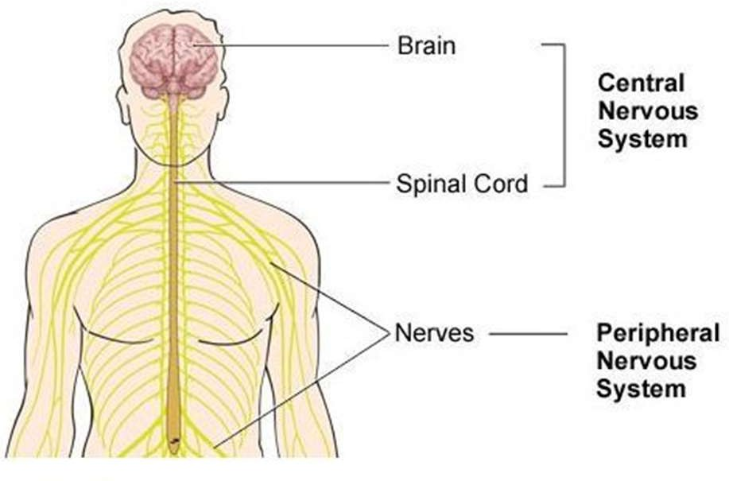
Central nervous system
CNS composed of Brain and Spinal cord
Brain: central organ of CNS. It is protected by skull bone of head. It receives the information from sensory organ and make the decision and send to the other organ.
Spinal cord: long thin tubular structure made up of nerve tissue. It can transmit nerve impulse from motor cortex to body and from sensory neuron to sensory cortex.

Slide 10
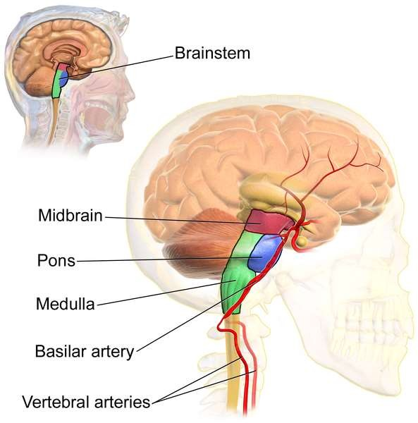
The Brain
The brain lies within the skull and is shaped like a
mushroom. The brain consists of four principal parts:
The brain stem
The cerebrum
The cerebellum
The diencephalon

Slide 11
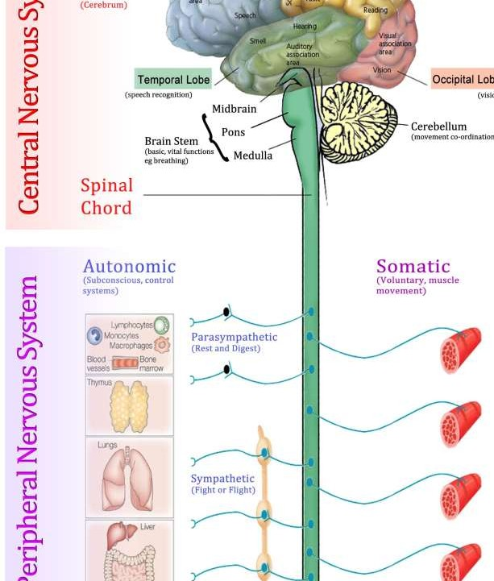
Brain
Cerebrum: largest part of brain divided into two hemisphere by longitudinal fissure. Each hemisphere divided into 4 lobes. Outer part is called cerebral cortex made up of grey matter which covers white matter.
Cerebellum: divided into anterior lobe and posterior lobe. It consists of inner medulla of white matter and outer cortex of grey matter.
Brain stem: it lies beneath the cerebrum and consists of mid brain, medulla, pons. It contain some cranial nerve to control eye movement, breathing control.

Slide 12
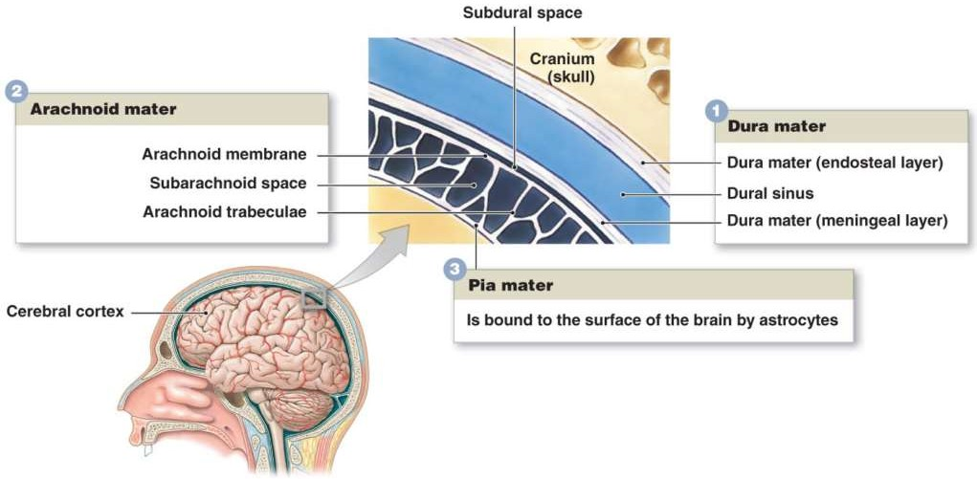
Meninges
It is the outer covering of brain and spinal cord, contain 3 membrane.
Most tough and outer membrane is dura mater;
the middle one is arachnoid mater and
the inner membrane is
pia mater.
Between the arachnoid mater and the pia mater subarachnoid space is present which contain cerebrospinal fluid.

Slide 13
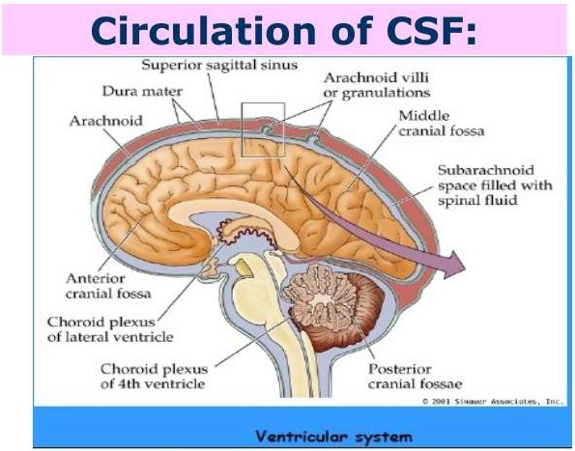
CSF
It is clear, colourless, transcellular fluid that circulates in the subarachnoid space, ventricles, and central canal. In 4 ventricle, choroid plexus can produce CSF. By 3 aperture in 4th ventricle CSF passes to the subarachnoid space.
CSF contain low chloride and same sodium as blood plasma. It contain 0.3% plasma protein.
It gives buoyancy, protection, maintain homeostasis, control intracranial pressure, remove metabolic waste from brain

Slide 14
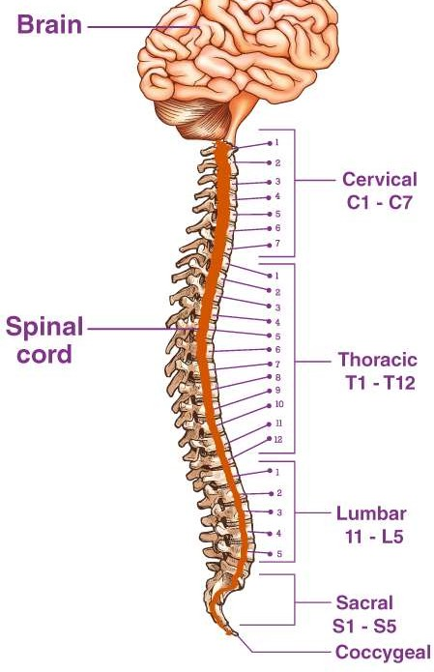
Spinal Cord
In adults, the spinal cord is usually 40cm long and 2cm wide. It forms a
vital link between the brain and the body.
The spinal cord is divided into five different parts.
Sacral cord
Lumbar cord
Thoracic cord
Cervical cord
Coccygeal
Several spinal nerves emerge out of each segment of the spinal cord. There are 8 pairs of cervical, 5 lumbar, 12 thoracics, 5 sacral and 1 coccygeal pair of spinal nerves.
Cross-section of spinal cord displays grey matter shaped like a butterfly
surrounded by a white matter.
Grey matter consists of the central canal at the centre and is filled with a fluid called CSF (Cerebrospinal fluid). It consists of horns (four projections) and forms the core mainly containing neurons and cells of the CNS. There are two dorsal and two ventral horns.

Slide 15
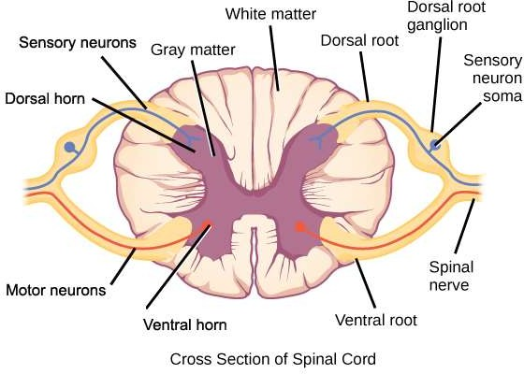
Cross-section of spinal cord displays grey matter shaped
like a butterfly surrounded by a white matter.
Grey matter consists of the central canal at the centre and is filled with a fluid called CSF (Cerebrospinal fluid). It consists of horns (four projections) and forms the core mainly containing neurons and cells of the CNS. There are two dorsal and two ventral horns.
Function Of Spinal Cord
Important functions of Spinal Cord are mentioned below:
Forms a connecting link between the brain and the PNS
Provides structural support and builds a body posture
Facilitates flexible movements
Myelin present in the white matter acts as an electrical insulation
Communicates messages from the brain to different parts of the body
Coordinates reflexes
Receives sensory information from receptors and approaches towards the brain for processing.

Slide 16


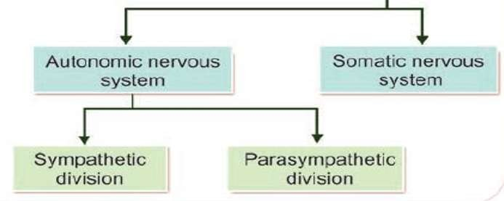
Peripheral Nervous System
“Peripheral nervous system involves the parts of the nervous system outside the brain
and the spinal cord.”
somatic nervous system
The main function of the somatic nervous system is to transfer impulses from CNS to skeletal muscles. It consists of-
Cranial Nerves
Spinal Nerves

Slide 17
A set of 12 peripheral nerves emerging from the brain that innervate the structures of the head, neck, thorax and abdomen.
Cranial nerves
Nerve name | Nerve no | Function
Olfactory nerve | CN I | Sense of smell
Optic nerve | CN II | Sense of vission
Oculomotor nerve | CN III | Ability to move and blink your eyes.
Trochlear nerve | CN IV | Ability to move your eyes up and down or back and forth.
Trigeminal nerve | CN V | Sensations in your face and cheeks, taste and jaw movements.
Abducens nerve | CN VI | Ability to move your eyes.
Facial nerve | CN VII | Facial expressions and sense of taste.
Auditory/vestibulocochl ear nerve | CN VIII | Sense of hearing and balance.
Glossopharyngeal nerve | CN IX | Ability to taste and swallow.
Vagus nerve | CN X | Digestion and heart rate.
Accessory nerve (or spinal accessory nerve) | CN XI | Shoulder and neck muscle movement.
Hypoglossal nerve | CN XII | Ability to move your tongue.

Slide 18
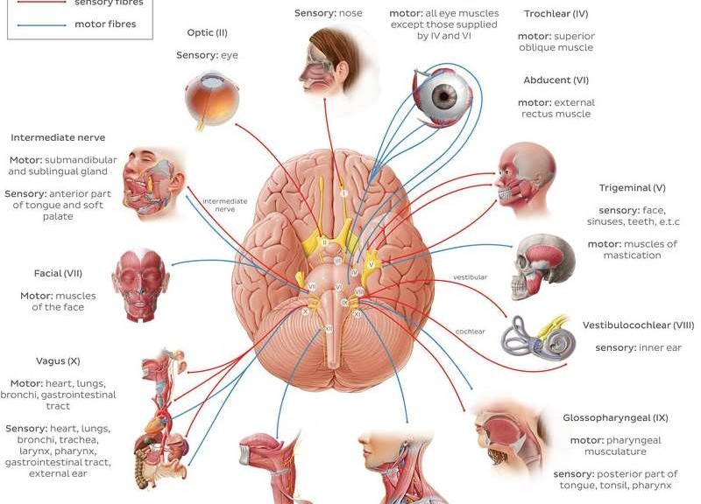


Slide 19
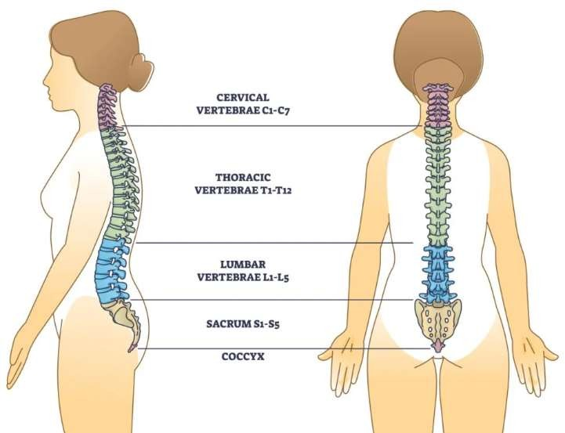
Spinal nerves
Have their point of emergence as the spinal cord. There are 31 pairs of spinal nerves. They emerge from the spinal
cords into dorsal and ventral roots. At the
two
junction of these
roots, the sensory fibres continue into the dorsal root and the motor fibres into the ventral root.

Slide 20

Autonomic nervous system
The autonomic nervous system is the part of the peripheral nervous system that regulates the basic visceral processes needed for the maintenance of normal bodily functions. It operates independently of voluntary control, although certain events, such as stress, fear, sexual excitement, and alterations in the sleep-wake cycle, change the level of autonomic activity.
The autonomic system consists of two major divisions: the
sympathetic nervous system and
the parasympathetic nervous system.
•
The sympathetic nervous system
normally functions to produce localized adjustments such
as sweating as a response to an increase in temperature and reflex, adjustments of the cardiovascular system. Its general action is to mobilize the body’s nervous system fight-or-flight response; it is also constantly active at a basal level to maintain homeostasis.
•
The parasympathetic nervous system
is an anatomically defined division of the autonomic nervous
system, being that part whose motor components run in cranial nerves III, VII, IX, and X and in the sacral nerves.

Slide 21
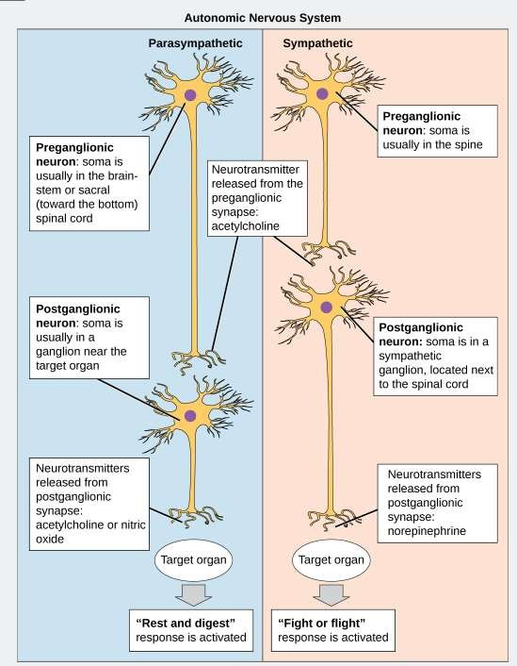

Slide 22
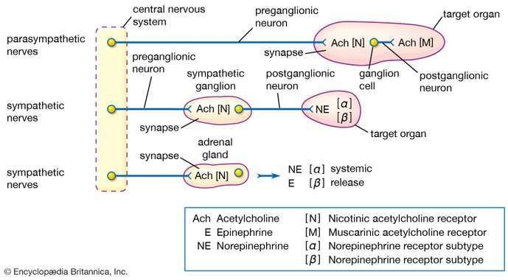

Slide 23

Peripheral Nervous System Functions
Following are the important functions of the peripheral nervous system:
The peripheral nervous system connects the brain and the spinal cord to the rest of the body and the
external environment.
It regulates internal homeostasis.
It can regulate the strength of muscle contractility.
It controls the release of secretions from most exocrine glands.

Slide 24
