Slide 2
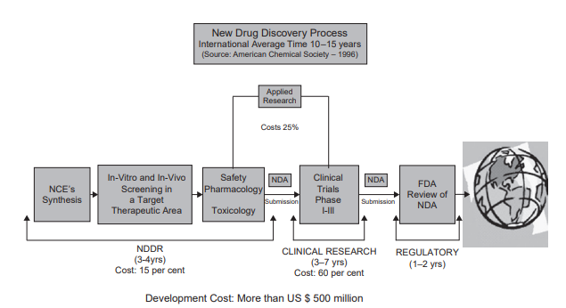
STAGES OF DRUG DISCOVERY
(2000 million dollars)

Slide 3
Medicinal Chemistry
A discovery step, involving the choice of the therapeutic target (receptor, enzyme, transport group, cellular, or in vivo model) – lead
An optimization step, which deals with the improvement of the lead structure.
A development step, whose purpose is the continuation of the improvement of the pharmacokinetic properties and the fi ne-tuning of the pharmaceutical properties (chemical formulation) of the active substances in order to render them suitable for clinical use.
Notes:
Medicinal chemistry involves the discovery, development, identifi cation, and interpretation of the mode of action of biologically active compounds at the molecular level. Emphasis is put on drugs, but the signifi cance of medicinal chemistry is also concerned with the study, identifi cation, and synthesis of the metabolic products of drugs and related compounds. Medicinal chemistry covers three critical steps.
• A discovery step , involving the choice of the therapeutic target (receptor, enzyme, transport group, cellular, or in vivo model) and the identifi cation (or discovery) and production of new active substances interacting with the selected target. Such compounds are usually called lead compounds ; they can originate from synthetic organic chemistry, from natural sources, or from biotechnological processes. Drug design aims at the development of the drugs with high specifi city and therapeutic index.
• An optimization step , which deals with the improvement of the lead structure. The optimization process takes primarily into account the increase in potency, selectivity, and toxicity. Its characteristics are the establishment and analysis of structure–activity relationships, in an ideal context to enable the understanding of the molecular mode of action. However, an assessment of the pharmacokinetic parameters such as absorption, distribution, metabolism, excretion, and oral bioavailability is almost systematically practiced at an early stage of the development in order to eliminate unsatisfactory candidates.
• A development step , whose purpose is the continuation of the improvement of the pharmacokinetic properties and the fi ne-tuning of the pharmaceutical properties (chemical formulation) of the active substances in order to render them suitable for clinical use. This chemical formulation process can consist in the preparation of better-absorbed compounds, of sustained release formulations, and of water-soluble derivatives, or in the elimination of properties related to the patient’s compliance (causticity, irritation, painful injections, and undesirable organoleptic properties).

Slide 4
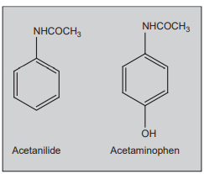
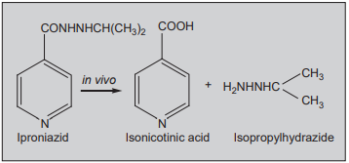
Lead from metabolite
Notes:
Acetanilide was known for many years to be an analgesic (painkiller). It was subsequently found that acetanilide is metabolized to acetaminophen (Paracetamol) in the liver. Today, acetaminophen is one of the leading over-the-counter pain medications.
Iproniazid is a monoamine oxidase inhibitor (MAOI) that was developed as the fi rst antidepressant. It was originally intended to treat tuberculosis but it was then discovered that patients given iproniazid became ‘inappropriately happy’; subsequently, further research on iproniazid revealed that it cleaved into isonicotinic acid (inhibits mycolic acid synthesis of Mycobacterium tuberculosis ), and isopropylhydrazide (inhibits MAO) in vivo . Isopropylhydrazide was responsible for antidepressant property, and from that lead, other drugs like phenalzine and isocarboxazide were developed.

Slide 5
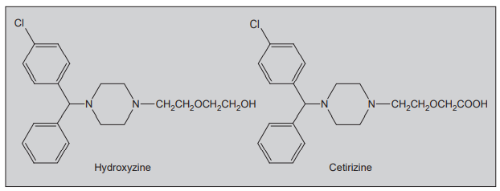
Lead from metabolite
Notes:
2.Hydroxyzine is a fi rst-generation antihistamine, of the piperazine class that is an H 1 receptor antagonist. It has the major drawback of sedation. It is metabolized in the liver; the main metabolite through oxidation of the alcohol moiety to a carboxylic acid is cetirizine. The metabolite was isolated and screened, and was found that because of carboxylic acid group in its structure it was not able to cross the blood brain barrier of the central nervous system. Cetirizine is the second-generation antihistamine devoid of sedation

Slide 6
Leads from side effects
Minoxidil – vasodilator – for hair growth
Sildenafil-cardiovascular drug – treats penis erection- due to NO(nitric oxide) release
Notes:
Minoxidil is a vasodilator and was exclusively used as an oral drug to treat high blood pressure. It was, however, discovered to have the interesting side effects of hair growth and reversing baldness, and in the 1980s, Upjohn Corporation produced a topical solution that contained two per cent minoxidil to be used to treat baldness and hair loss.
During the clinical trial (Phase I) of cardiovascular drug sildenafi l, it was observed that penile erections were a common side effect in the multiple dose of sildenafi l. Furthermore, emerging data implicated nitric oxide (NO) as a key mediator of the neural and haemodynamic effects that lead to penile erection in men. In particular, in the early 1990s, Ignarro and others reported that NO is the neurotransmitter that is released from cavernous nerves during sexual stimulation. The NO diffuses into vascular smooth muscle cells of the penis, stimulating the production of cGMP and leading to corpus cavernosum smooth muscle relaxation, vasocongestion, veno-occlusion (by constriction of the venous outfl ow from the penis against the tunica albuginea), and ultimately, erection. Sildenafi l is the fi rst drug marketed for the treatment of male erectile dysfunction discovered by exploitation of side-effects approach.

Slide 7
Random screening
no intellectualization
Prior to 1935 used
to discover drugs or leads that have unexpected and unusual structures for various targets.
Zidovudine (AZT) was the first drug approved for the treatment of AIDS.
1965 for cancer – 1985 for AIDS
Notes:
Random screening involves no intellectualization; all compounds are tested in the bioassay without regard to their structures. Prior to 1935, random screening was essentially the only approach; today, this method is used to a lesser degree. However, random screening programmes are still very important in order to discover drugs or leads that have unexpected and unusual structures for various targets. Zidovudine (AZT) was the fi rst drug approved for the treatment of AIDS. Jerome Horwitz of Barbara Ann Karmanos Cancer Institute and Wayne State University School of Medicine fi rst synthesized AZT in 1964, under a US National Institutes of Health (NIH) grant. It was originally intended to treat cancer, but failed to show effi cacy and had an unacceptably high side-effect profi le. The drug then faded from view until February 1985, when Samuel Broder, Hiroaki Mitsuya, and Robert Yarchoan, three scientists in the National Cancer Institute (NCI), collaborating with Janet Rideout and several other scientists at Burroughs Wellcome, started working on it, and they have found that zidovudine inhibited HIV in vitro and marketed it as the fi rst AIDS drug.

Slide 8
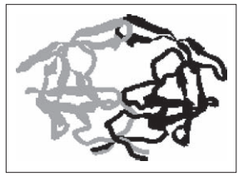
Rational drug design
The term ‘receptor’ was coined by Ehrlich in 1909 to describe the target.
3D XRD after many decades
HIV protease -1988

Slide 9
Drugs from Drug design
Cimetidine, the prototypical H2-receptor antagonist from which the later members of the class were developed
Dorzolamide, a carbonic anhydrase inhibitor used to treat glaucoma
Many of the a typical antipsychotics
Selective COX-2 inhibitor NSAIDs
SSRIs (selective serotonin reuptake inhibitors), a class of antidepressant

Slide 10
Zanamivir, an antiviral drug
Enfuvirtide, a peptide HIV entry inhibitor

Slide 11
An analogue is normally accepted as being that modification which brings about a carbon-skeletal transformation or substituent synthesis.
Examples : oxytetracycline, demclocycline, chlortetracycline, trans-diethylstilbesterol with regard to oestradiol.
The term prodrug is applied to either an appropriate derivative of a drug that undergoes in vivo hydrolysis to the parent drug,
e.g., testosterone propionate, chloramphenicol palmitate and the like ; or an analogue which is metabolically transformed to a biologically active drug, for instance : phenylbutazone undergoes in vivo hydroxylation to oxyphenbutazone

Slide 12
‘Drug discovery process’ may be categorized into four distinct heads, namely :
(i) Target identification and selection
(ii) Target optimization
(iii) Lead identification and
(iv) Lead optimization

Slide 13
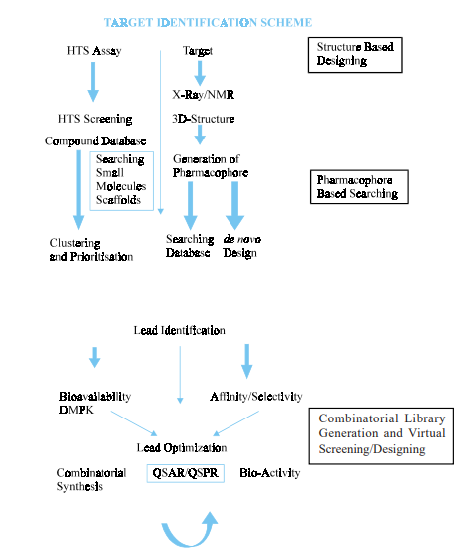
Rational drug design

Slide 14
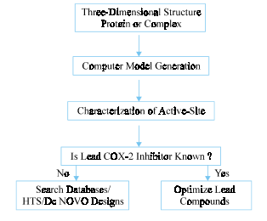
Flow chart for computer aided drug design

Slide 15
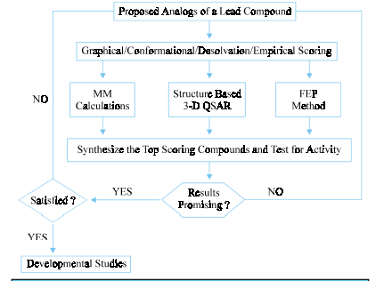
Lead optimization flow chart

