Slide 1
LESSON 8
LIMIT TEST OF ARSENIC:
Arsenic is a well known undesirable and harmful impurity, present in medicinal substances. All pharmacopoeias prescribe a limit test for it.
The pharmacopoeial method is known as Gutzeit Test.
PRINCIPLE: The test is based on the fact that arsenic in the arsenious state can easily be reduced to arsine gas (AsH3). When this gas is passed over mercuric bromide paper, it produces a stain which ranges in colour from yellow to brown. The intensity and length of which are proportional to the amount of arsenic present

Slide 2
According to B.P, mercuric chloride paper is used instead of mercuric bromide paper.
A standard stain prepared from a definite quantity of arsenic, is used for comparison and provides the limit, which the sample under test must not exceed.
Reduction of Arsenic to Arsine gas:
The reduction from arsenic to arsine, both in the standard and sample, may be achieved by the combined actions of zinc, stannous acid, potassium iodide etc.
When the sample is dissolved in acid, the arsenic present in the sample gets converted to arsenic acid which gets reduced by reducing agents (like potassium iodide, stannous acid etc.) to arsenious acid.
The nascent hydrogen formed during the reaction further reduces arsenious acid to arsine gas, which reacts with mercuric chloride paper giving a yellow stain.
The test is carried out in a specified apparatus. Reaction involved in the method:
H3AsO3 + H2SnO2 H3AsO3 + H2SnO3
Arsenic acid + stannous acid arsenious acid

Slide 3
H3AsO3 + 3H2 AsH3 + 3 H2O
Arsenious acid + hydrogen Arsine gas
AsH2
2AsH3 + HgCl2 Hg + 2HCl
AsH2
Mercuric arsenide stain
All reagents used for the limit test of arsenic should be free from arsenic and designated as AsT in pharmacopoeias

Slide 4
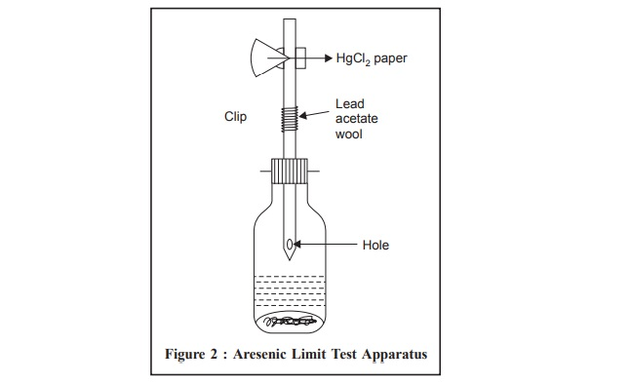

Slide 5
APPARATUS:
⦁ It is having a wide mouthed glass bottle of 120 ml capacity (diameter of mouth of the bottle is 2.5 cm).
⦁ The bottle is fitted with a rubber bung through which passes a glass tube of 200 mm long, having an external diameter of 8 mm and an internal diameter of 6.5 mm.
⦁ The tube is constricted at its lower end and there is a hole near the constricted part, not less than 2 mm in diameter.
⦁ The upper end of the glass tube has been fitted with two rubber bungs, each having a hole (diameter- 6.5 mm) bored centrally.
⦁ One of the bungs has been fitted to the upper end of the tube, while the second bung has to be fitted upon the first bung in such a way that mercuric chloride paper gets exactly sandwiched between the central perforations (holes) of the two.
⦁ The bungs are kept in close contact by using a spring clip is such a manner that gas evolved from the bottle must have to pass through the internal circle (diameter-6.5mm) of mercuric chloride paper.
⦁ During the test, the hole near the constricted part of the glass tube (lower portion) serves as an exit for water which condenses in the constricted part of the tube.
⦁ An important feature of the apparatus has been the standardization of the area of mercuric chloride paper which is exposed to the arsine gas.

Slide 6
Reagents and material required for the test:
⦁ Hydrochloric acid AsT
⦁ Potassium iodide AsT
⦁ Zinc AsT
Nitric acid AsT
⦁ Sodium carbonate As T
⦁ Stannous acid AsT
⦁ Potassium chlorate AsT
⦁ Mercuric chloride paper AsT
PROCEDURE:
The glass tube is first of all lightly packed with cotton wool, which is previously moistened with solutions of lead acetate and dried.
Reason: because if impurity of Hydrogen sulphide gas (metallic zinc may contain traces of sulphide which on reaction with acid yields H2S) is present, it will get trapped by lead acetate present in cotton; otherwise this gas will itself stain the mercuric chloride paper

Slide 7
⦁ The cotton has been so arranged in the tube that the upper surface of the cotton should not be less than 2.5 cm below the top of the tube and has been lightly packed to allow the arsine gas quite efficiently.
⦁ Then the mercuric chloride paper is placed in between the upper two bungs, fitted by using a spring clip.
⦁ Then the test solution containing- 5ml of 1 gm of the substance to be examined is kept in the wide mouthed bottle. To this 5 ml of 1 gm of potassium iodide (KI AsT), 5 ml of stannous chloride acid solution AsT and 10 gms of zinc Zn AsT are added.
⦁ Then the glass tube is kept in position quickly and the action is allowed to continue for 40 mins.
⦁ A yellow stain which gets produced on the mercuric chloride paper, if arsenic is present, has been compared by day light with the standard stain-which is produced by operating in a similar manner with known quantities of dil. Arsenic solution.
⦁ The most suitable temperature for running the test is generally about 40® Celsius.
⦁ The comparison of the stains is done immediately at the completion of the test and the standard stains as they start fading while keeping. So both these tests i.e. test & standard should be carried out simultaneously

Slide 8
Preparation of Standard Stain:
Standard stains are produced by using dilute arsenic solution. Limit of Arsenic is 1 parts per million (1 ppm).
Dilute arsenic solution 0.132 gm of As2O3/100 ml
Now, from this arsenic solution of 100 ml let us take 1 ml. This 1 ml is diluted with 100 ml of water. Again take 1 ml of this solution. Therefore this 1ml solution now contains 0.00001 gm of arsenic which is proportional to 1*10-6 or 1 parts per million.
If the sample under investigation shows a stain of lesser intensity than that of the standard then the sample passes the test.
Notes:
⦁ Care must be taken that the mercuric chloride paper remains dry throughout the test.
⦁ The most suitable temperature for carrying out the test is generally 40® Celsius.
⦁ The tubes must be washed with hydrochloric acid AsT, rinsed with water and dried between successive tests.
⦁ Stannous chloride is required for the complete evolution of arsine. Stannous salts reduce arsenic to arsenious state.
⦁ It is very essential to maintain the rate of evolution of hydrogen gas by using particular size of zinc, controlling the concentration of acids and other salts of the reaction along with the temperature.
⦁ Rapid evolution gives rise to a long and diffuse stain while a slow evolution gives rise to a short stain of intense colouration.

